Slide 1
BOARD GAME
FINDER
Find the game for tonight
Group members
Aoxue Li
Ezeme Onyenezi Innocent
Zhi Zhou

Slide 2
BOARD GAME FINDER/THE IDRA
Turn winter nights
into game nights
We help people in Finland find the interesting board game for solo play or an evening with friends.

Slide 3
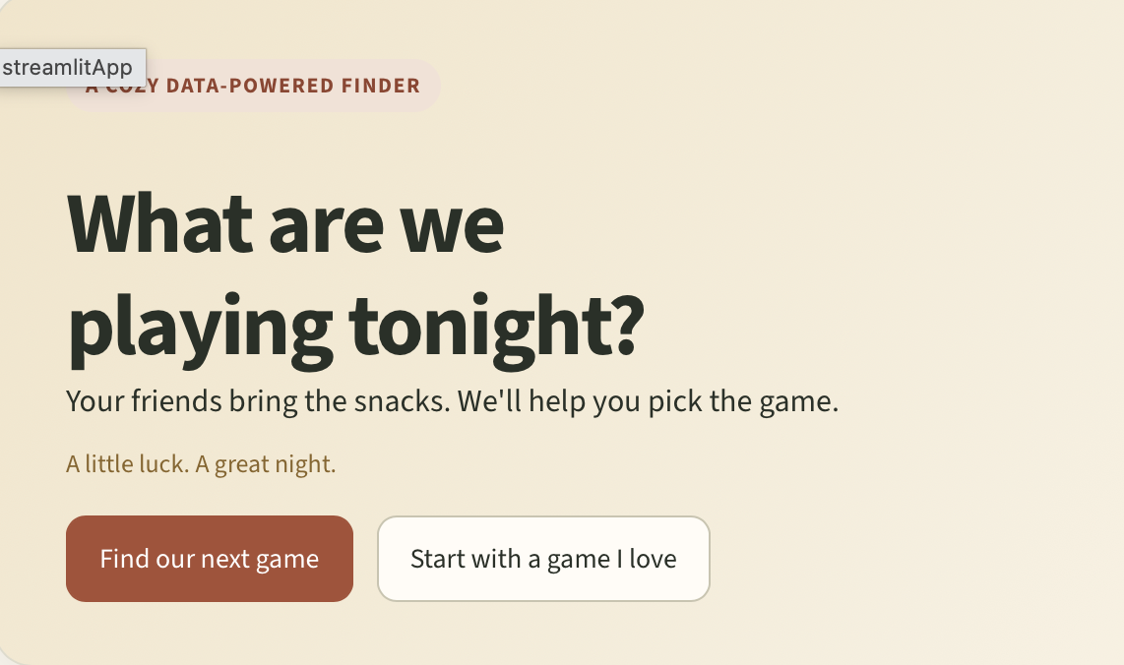
01
Game night
starts here.
Too many options. No clear pick
Alone or with friends, choosing what to play can take longer than the game itself.
Find your game in a few quick choices.
bgg-mini-project.streamlit.app/find
02
A game that fits tonight
Choose players, time and complexity—or discover games similar to one you already love.

Slide 4
BOARD GAME FINDER/YOUR NEXT MOVE
02 Better picks.
Warmer nights.
01 Match the moment
03 Tonight is game night
Pick your player count, time and complexity.
Find clear matches among 2,077 BGG games, each with 100+ ratings.
Our warm colours bring a little sunshine to winter evenings.
Winter is coming.
Try our game finder now and discover what to play tonight.

